Slide 1
Lending Club Case Study
- Neha Sharma and Rawoof Mohammad

Slide 2
Purpose
This case study analyzes a consumer finance company specializing in lending diverse types of loans to urban customers.
The primary objective is to identify predictive patterns and factors that indicate the likelihood of loan default.
These insights will help form strategic decisions such as denying loans, reducing loan amounts, or adjusting interest rates for higher-risk applicants.

Slide 3
Steps
Importing the data
Removing the attributes with null values
Removing the attributes with only single value
Correcting the data types and value formats
Fixing attributes with null values
Removing the attributes that are not relevant
Removing outliers if any
Deriving new columns as needed
Univariate, Bivariate and multivariate analysis

Slide 4
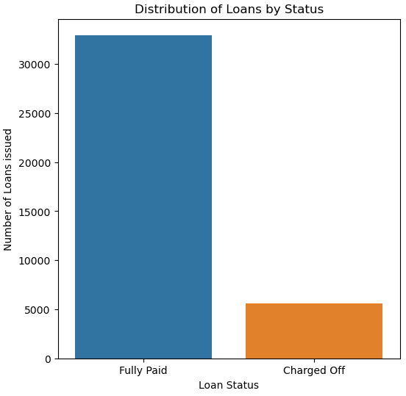
Distribution of loans by status - The no. of charged off loans is very less as compared to loans that were fully paid. - Almost 82.97% of total loans were fully paid , 14.18% were charged off and remaining are the ongoing loans.

Slide 5
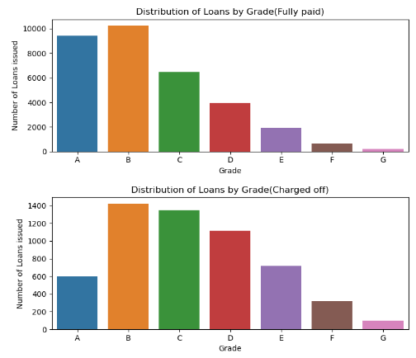
Distribution of loans by Grades - Overall , more loans were given to grades A,B and C. - Out of which, more charged off loans belongs to grades B and C.

Slide 6
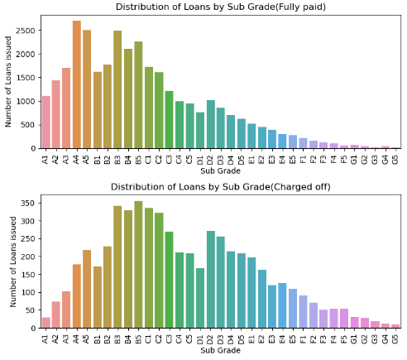
Distribution of loans by Sub-grades - Out of which, more charged off loans belongs to sub-grades B5,B3,B4 followed by C1 and C2.

Slide 7
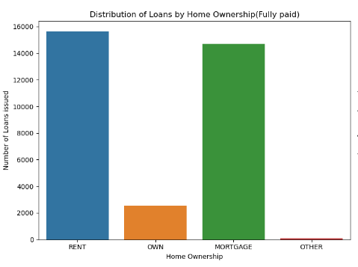
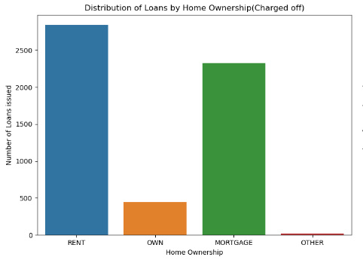
Distribution of loans by Home ownership
More loans are taken by people are on rent or mortgage and also have higher chances of defaulting.
Renters or homeowners with mortgages may already have significant monthly financial commitments, such as rent or mortgage payments, utilities, insurance, housing expenses, etc. Taking on additional loans can lead to a higher debt-to-income ratio, making it harder to manage repayments, especially if their income fluctuates or decreases.

Slide 8
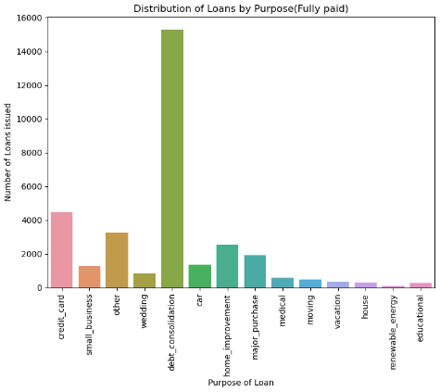
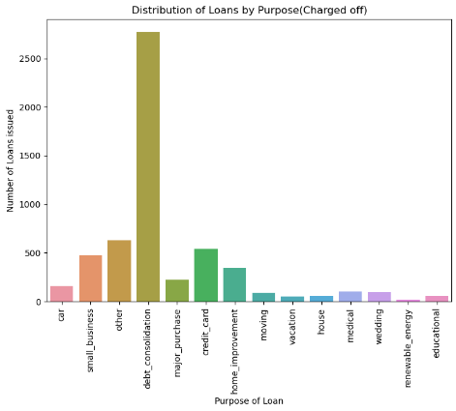
Distribution of loans by Purpose
More loans are taken by people for debt consolidations and repaying credit card bills
People often take out loans for debt consolidation to streamline payments and manage various debts like credit cards and medical bills. However, if their financial situation worsens or they misjudge their repayment capability, these consolidation loans can become challenging to handle, potentially resulting in defaults.

Slide 9
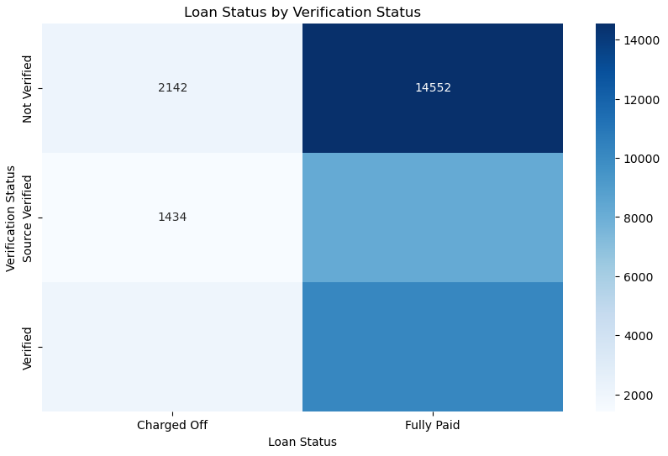
Verification status - Most of the non-verified loans are paid off hence the nature of loan re-payment is not dependent upon the verification status.

Slide 10
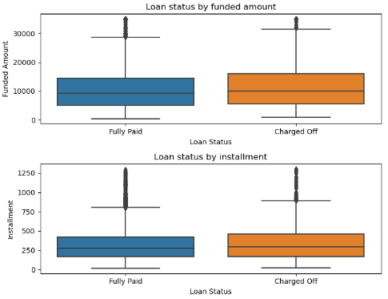
Loan amount & Installment - There is a very little difference in loan amount and installment among both fully paid and charged off loans. - Funded amount and installments both seems to be little higher for charged off loans than that for fully paid loans.

Slide 11
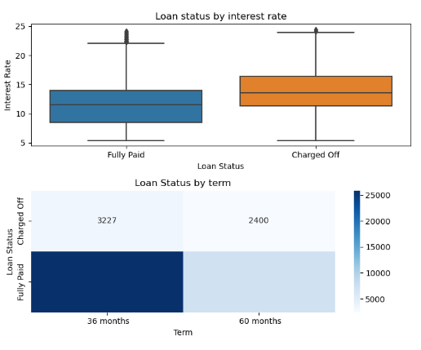
- Loans charged off typically had higher interest rates, signaling riskier loan terms that increase the likelihood of default. - A higher proportion of loans with a 3-year (36-month) term were charged off compared to those with a 5-year (60-month) term. - Shorter terms often mean higher monthly payments, which can impact borrower affordability and repayment ability.
Interest rate & Term

Slide 12
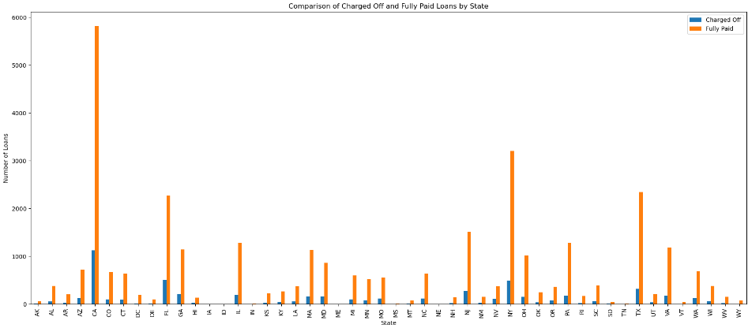
Analyzing Charged off loans and Fully paid loans in each state
Higher number of defaulted loans belonged to states CA,FL and NY likely due to economic factors.
Conversely, states with no defaulters such as AK, DC, DE, MT, SD, VT, and WY, though having fewer loans, demonstrate stronger repayment behavior.
These insights highlight the importance of regional risk assessment in lending practices.

Slide 13
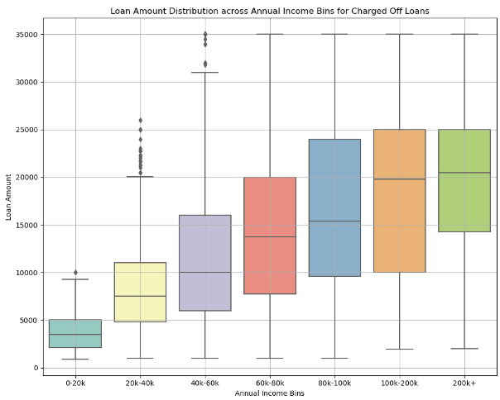
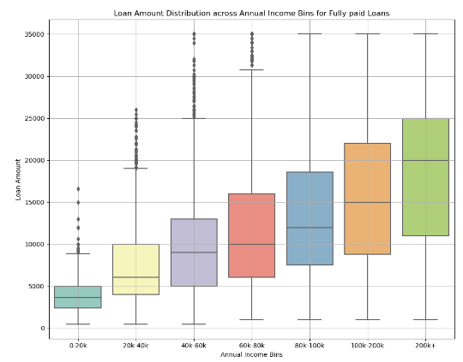
Analyzing Annual income vs loan amount
Need to conclude

Slide 14
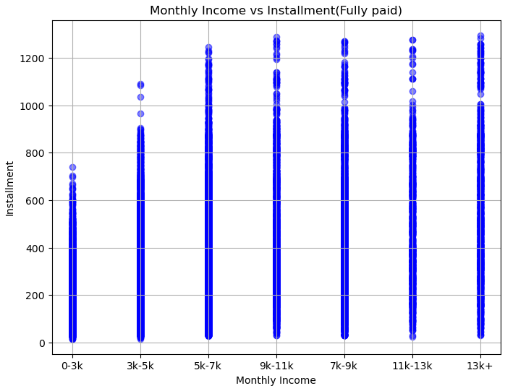
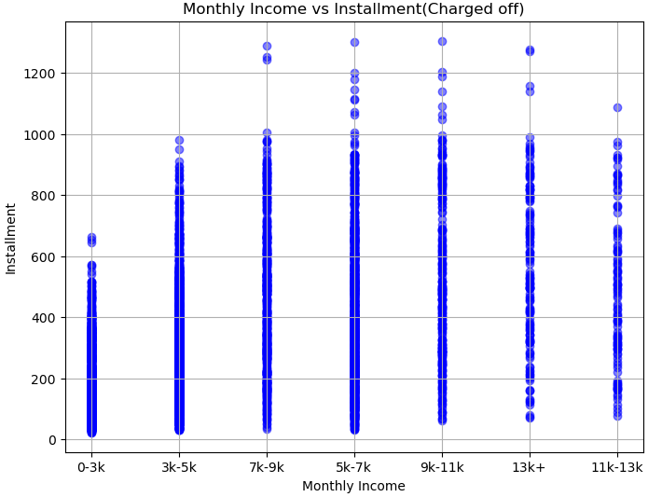
Analyzing Monthly income vs Installment
Need to conclude

Slide 15
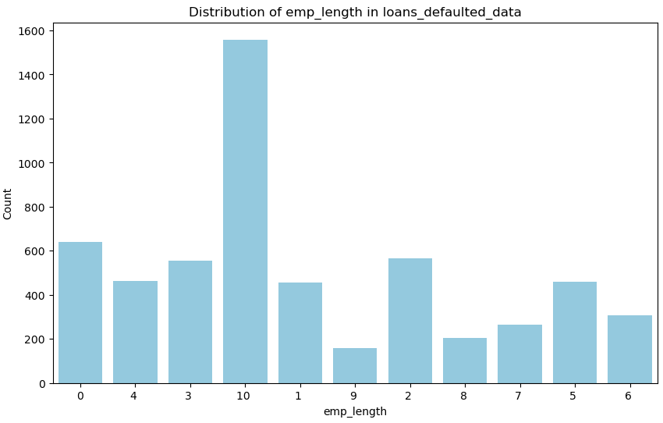
Analyzing employment length for charged off loans - Majority of charged off loans belonged to clients having 10+ years of experience .

Slide 16
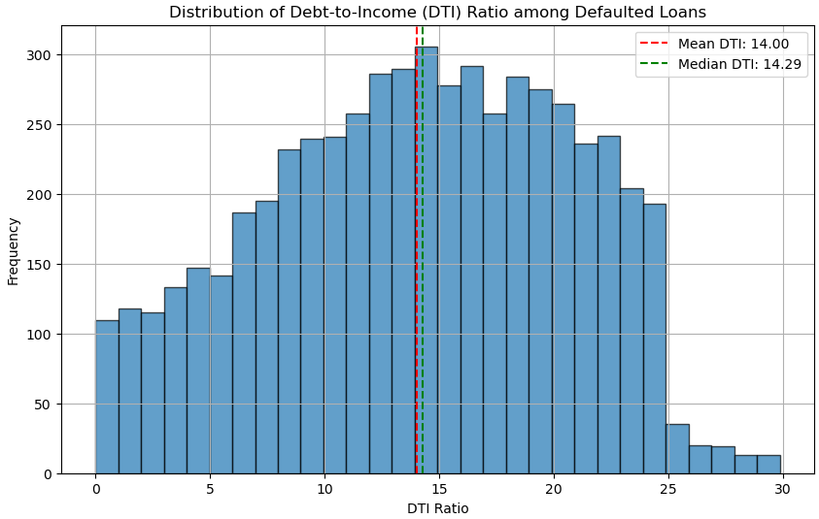
- Large percentage of people had higher debt to income ratio. - This imbalance indicates that borrowers may have struggled to manage loan repayments alongside existing financial obligations, potentially leading to default as their financial capacity became overstretched.
Analyzing DTI for charged off loans

Slide 17
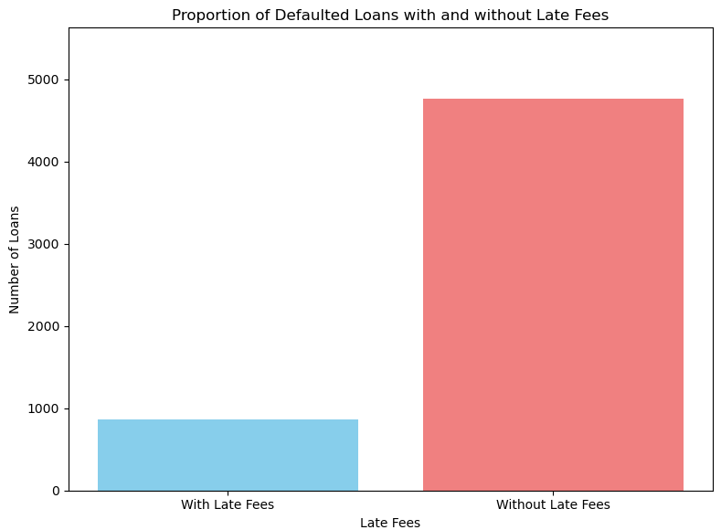
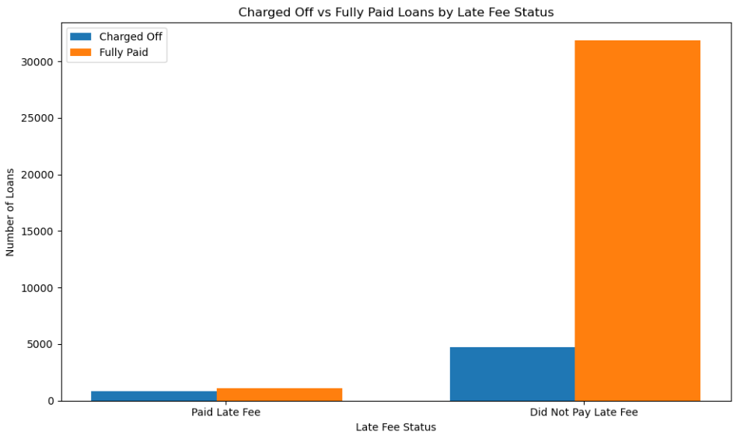
Analyzing late fees factor against defaulters
Number of people who paid late fees and defaulted were 863 out of total defaulted people of count 5627
However , total no. of people who paid late fees where 1995 out of which 863 defaulted and 1132 paid the loan.
Hence it can be concluded that , people with history of late fee payment will have 43% chance of becoming a defaulter.

Slide 18
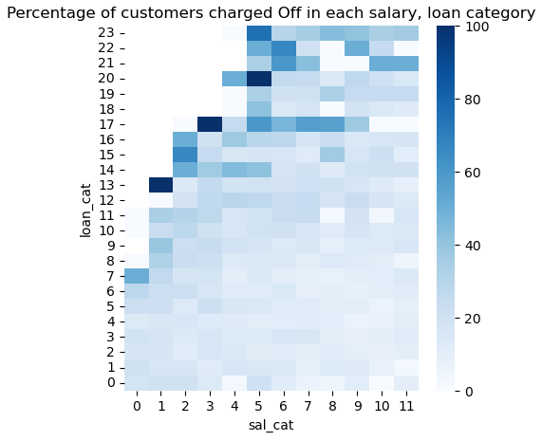

Slide 19
Conclusion

